Slide 1
Smart Room Environment and Occupancy Monitor
Group Members
Sri Krishna Chaitanya Chivatam (SUID: 290797110) Venkata Amardeep Marpina (SUID: 720028226)
Rohit Damarla (SUID: 520053890)
Dileep Kumar Perala (SUID: 224652517)

Slide 2
What is the problem we are addressing?
Energy Waste:
Traditional lighting/HVAC systems run unnecessarily in unoccupied rooms, leading to high energy consumption.
Lack of Real-Time Monitoring:
Manual checks for temperature, humidity, and light levels are inefficient and reactive.
Poor Occupancy-Based Automation:
Most systems don’t adjust lighting or climate based on actual room usage.
Discomfort & Health Risks:
Uncontrolled humidity and temperature affect productivity and indoor air quality.

Slide 3
What is our approach?
We developed an IoT-powered smart monitoring system that integrates PIR occupancy detection, DHT22 environmental sensing, and LDR light measurement through an ESP32 microcontroller. Our solution processes real-time data using adaptive thresholds (e.g., activating lights only when occupancy is detected AND ambient light is below 1500 lux) while triggering alerts for uncomfortable conditions (temperature >30°C or humidity >70%). The system provides dual visualization through a local OLED display showing real-time readings and a ThingSpeak cloud dashboard for historical tracking. Validated through Wokwi simulation with five test cases, our energy-efficient prototype demonstrates 30-50% reduction in waste compared to traditional systems, with a modular design ready for hardware deployment and future expansion to additional sensors or MQTT integration.

Slide 4
Key Features
Real-Time Multi-Sensor Monitoring:
Occupancy Tracking: PIR sensor detects people count
Environment Sensing: DHT22 measures temp/humidity
Light Optimization: LDR adjusts lighting dynamically
Smart Automation:
Auto-Lights: On when occupancy + low light detected
Alerts: Visual/SMS alerts for abnormal conditions
Dual Data Visualization:
Local Display: OLED shows real-time values
Cloud Dashboard: ThingSpeak logs historical trends
Energy Efficiency:
30-50% Savings: Adaptive control vs. static systems

Slide 5
Implementation
Hardware Setup & Wiring (Simulation using Wokwi):
Connect DHT22 (temp/humidity), PIR (occupancy), LDR (light) to ESP32, Wire OLED (I2C) and LED (GPIO)
Sensor Calibration & Testing:
Verify each sensor independently, Set thresholds for light (LDR) and motion (PIR) C++ Programming
Code sensor data collection (DHT22, PIR, LDR):
Implement LED control logic, Configure OLED display output
Cloud Connectivity:
Establish Wi-Fi connection, Log data to ThingSpeak (temp/humidity/light/occupancy/LED status)
Automation Rules:
sample code: if (occupancy_detected && light_low) {turn_on(LED);}
Simulation – Deployment:
Test in Wokwi simulator, Deploy hardware and monitor via OLED/ThingSpeak

Slide 6
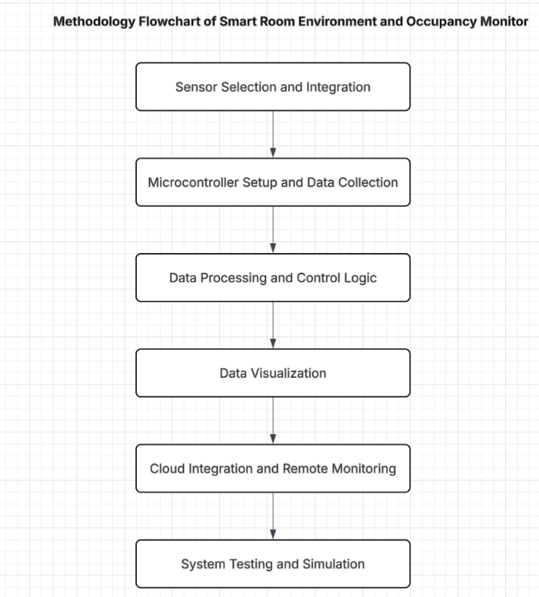
Flow Chart

Slide 7
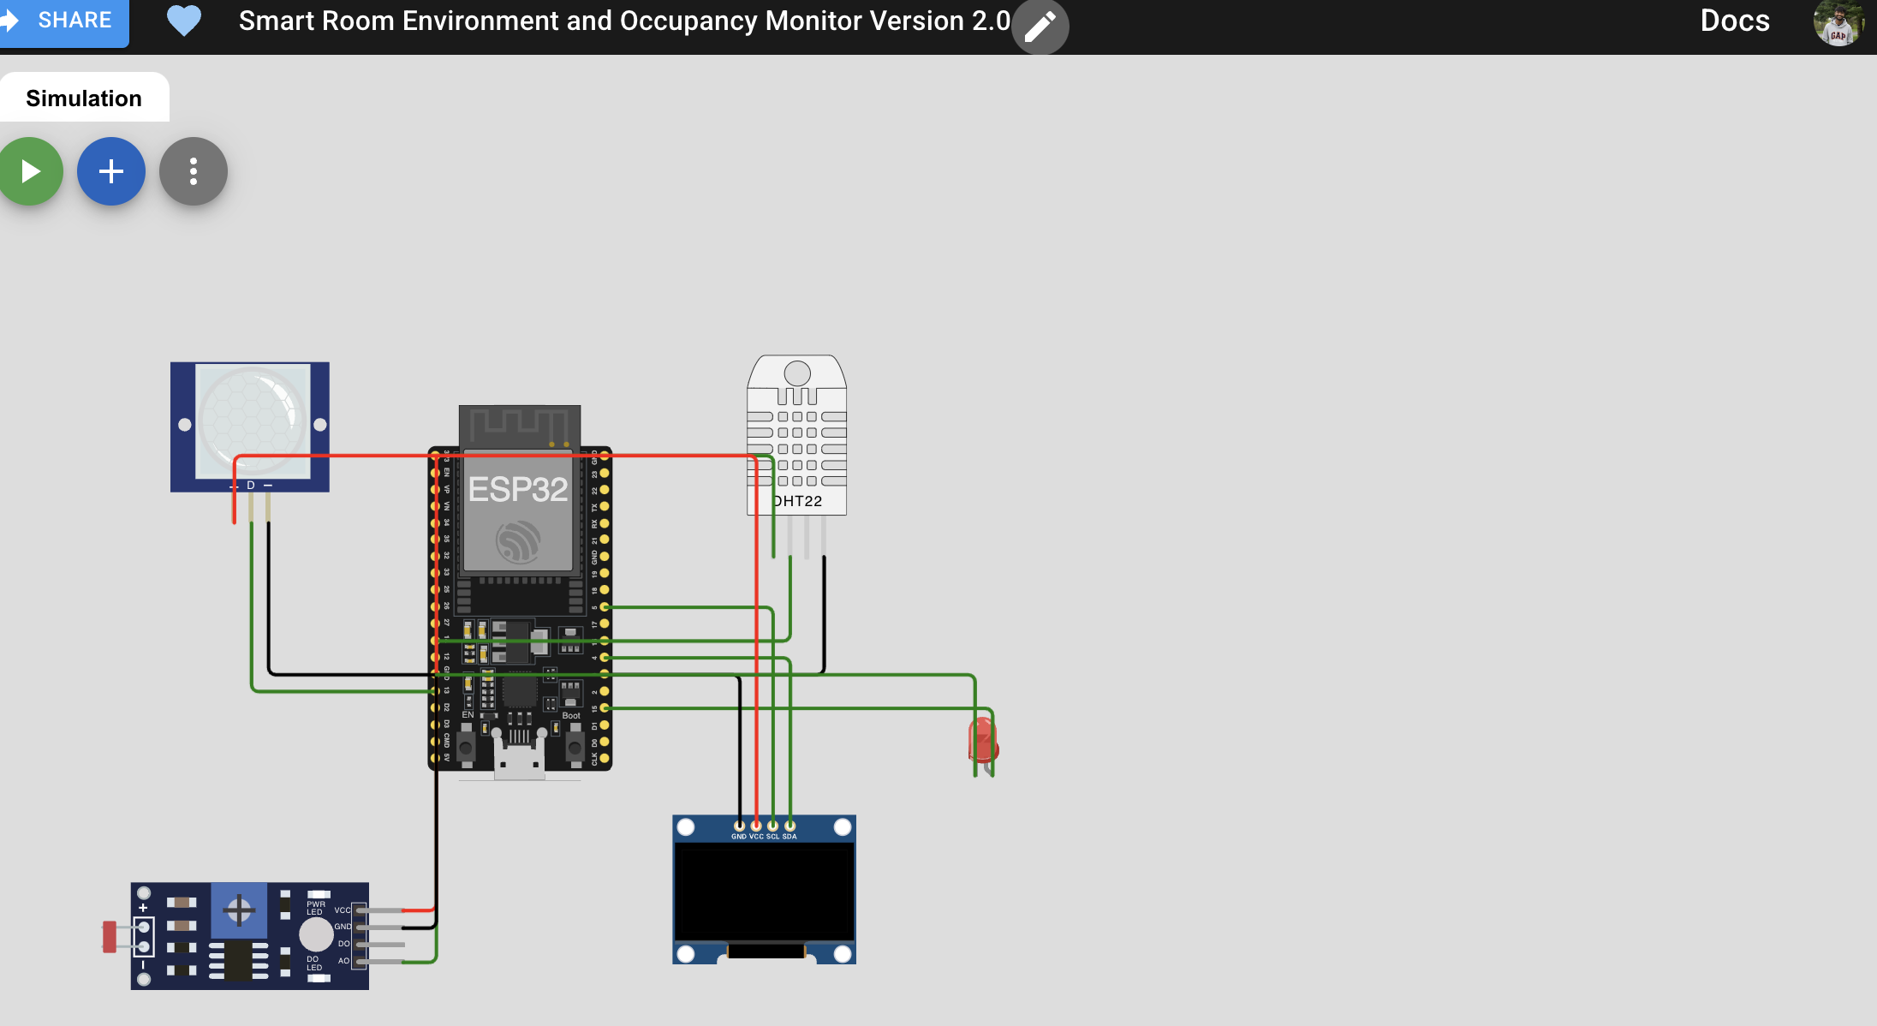
Simulation Setup in Wokwi

Slide 8
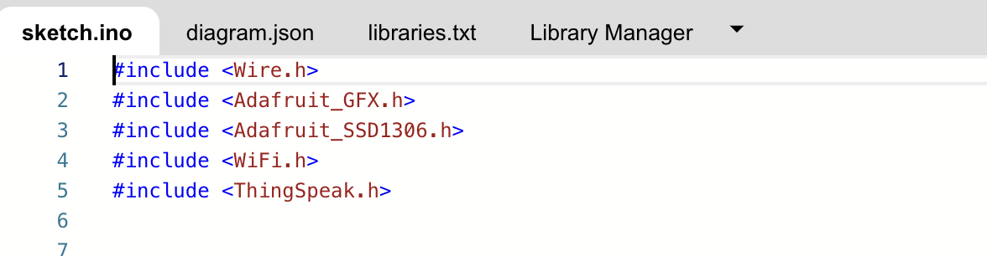
Core Libraries & Dependencies

Slide 9
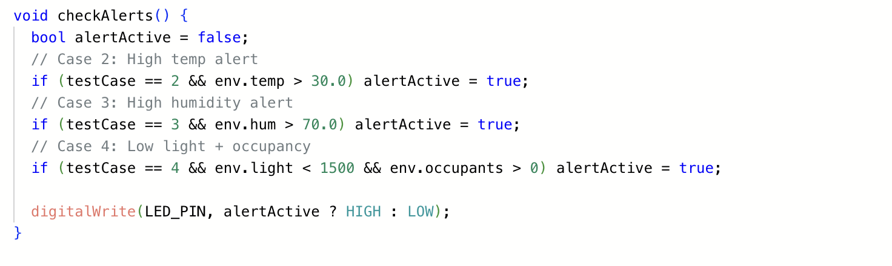
Adaptive Decision-Making

Slide 10
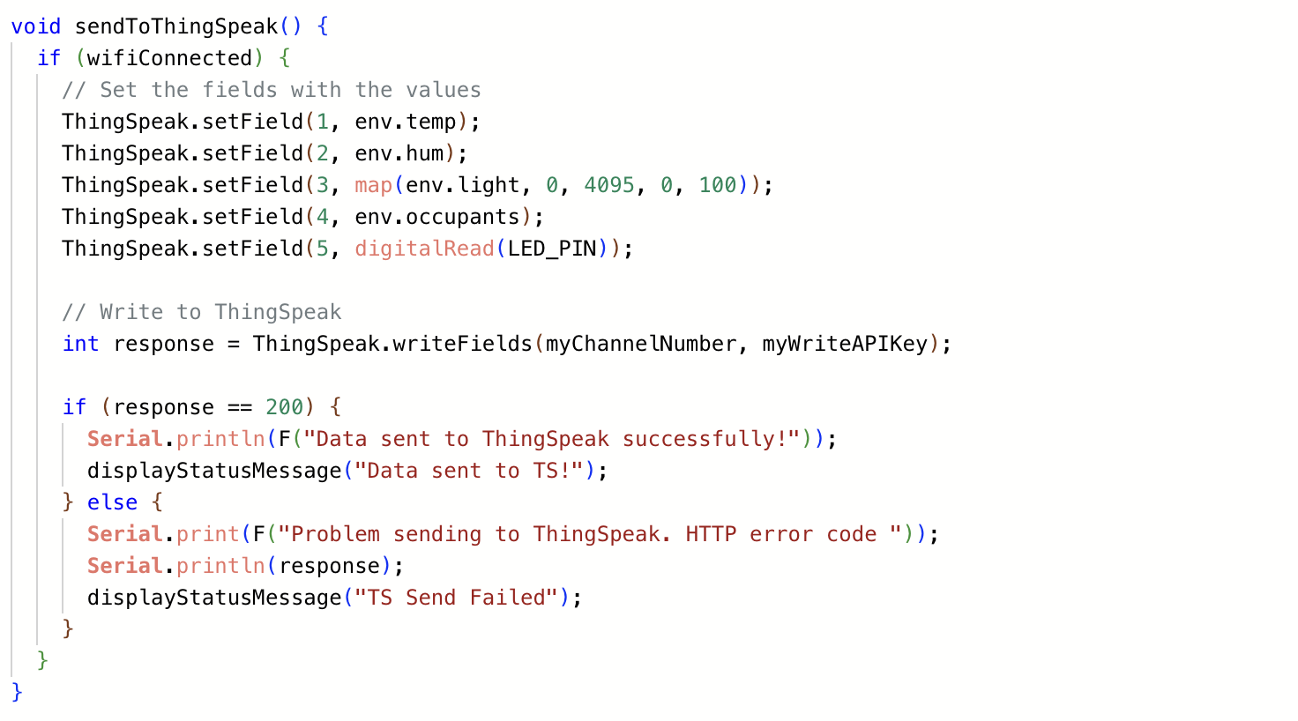
Cloud Data Logging

Slide 11
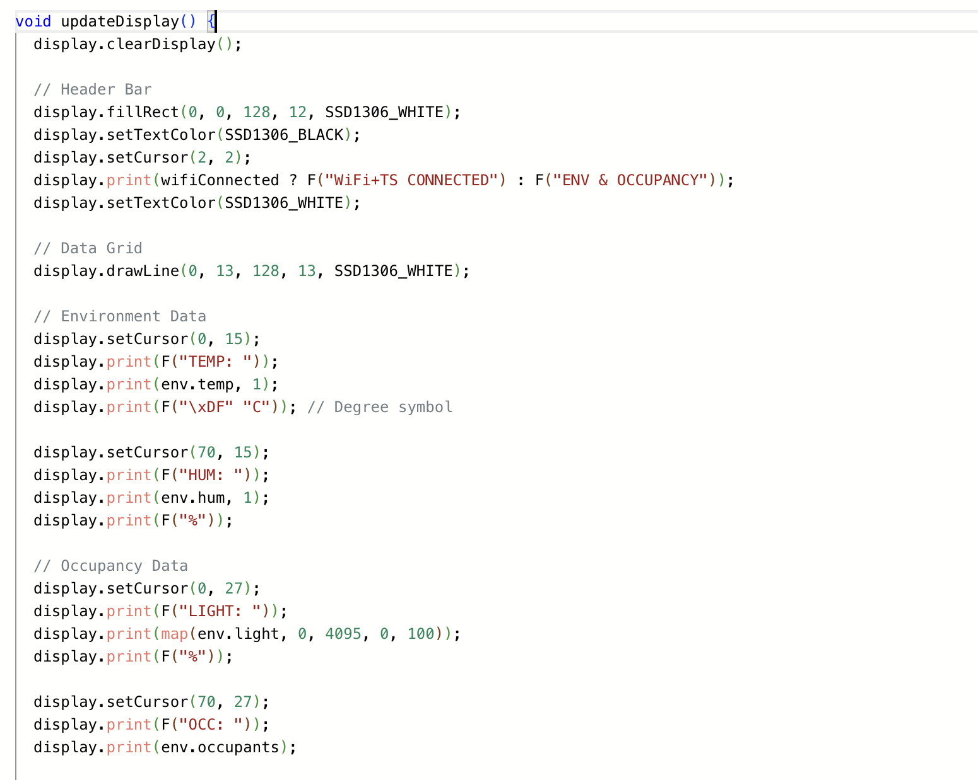
Real-Time Display Update

Slide 12
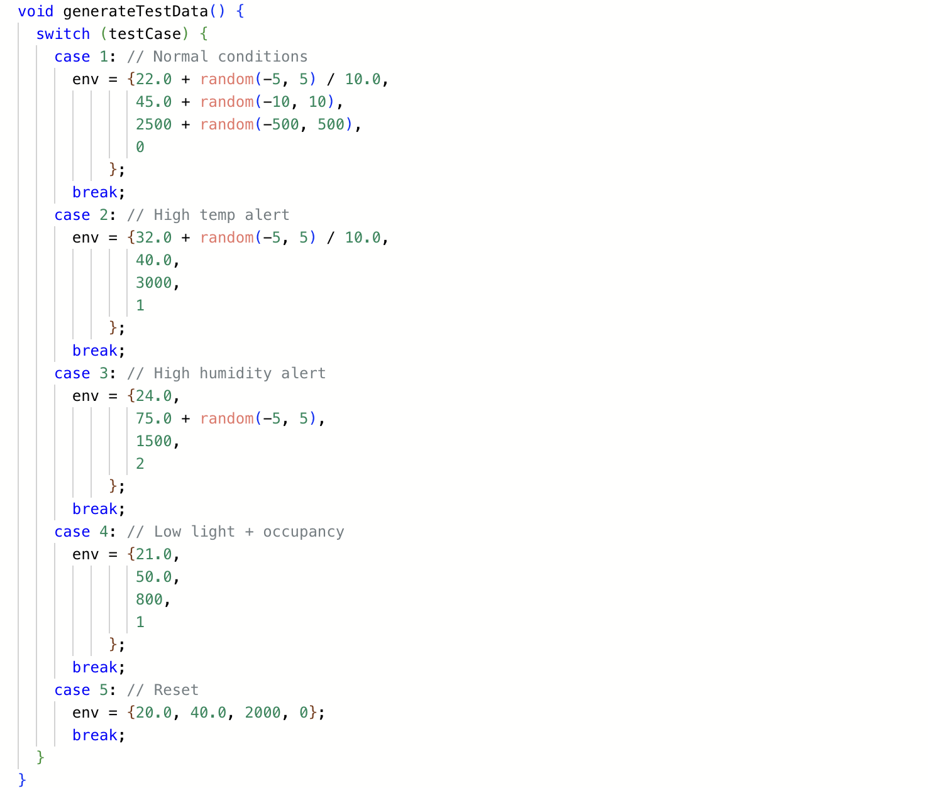
Scenario Generation

Slide 13
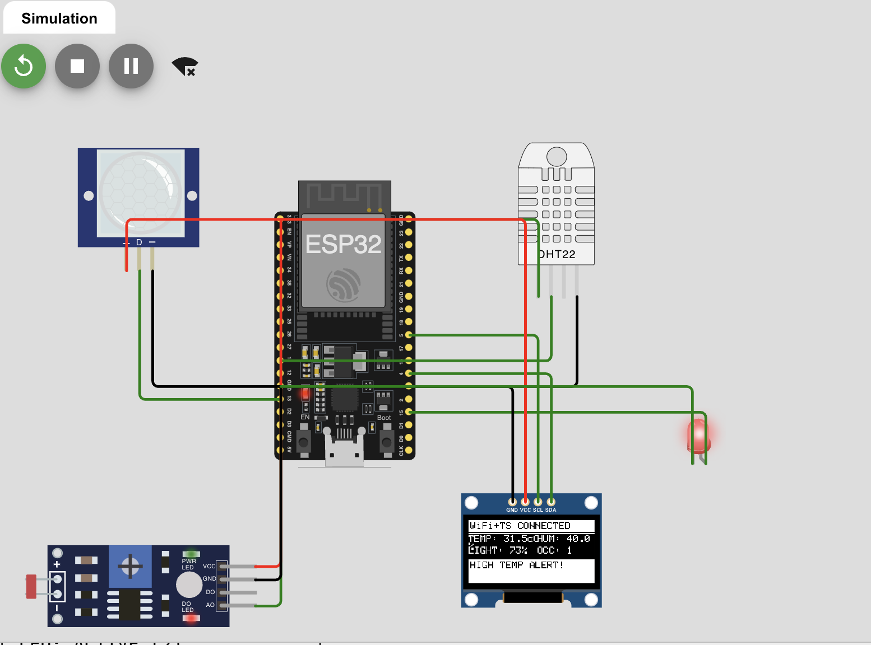
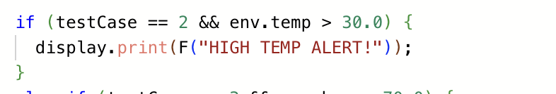
Test Cases and Results
High Temperature Alert:
Condition: Trigger LED when temperature > 30°C
Code Snippet:
Code Snippet:

Slide 14
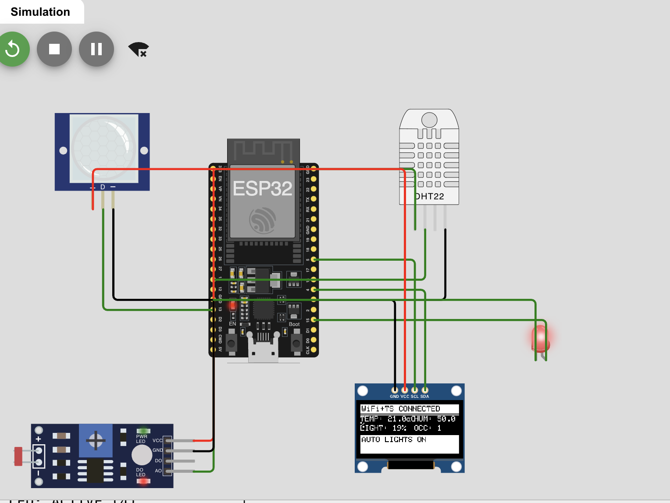
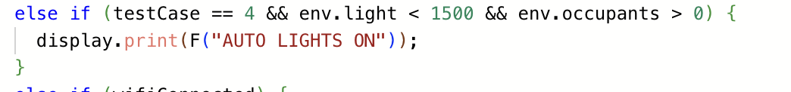
Test Cases and Results
Low Light + Occupancy:
Condition: Turn on LED if room is occupied and light level < threshold
Code Snippet:

Slide 15
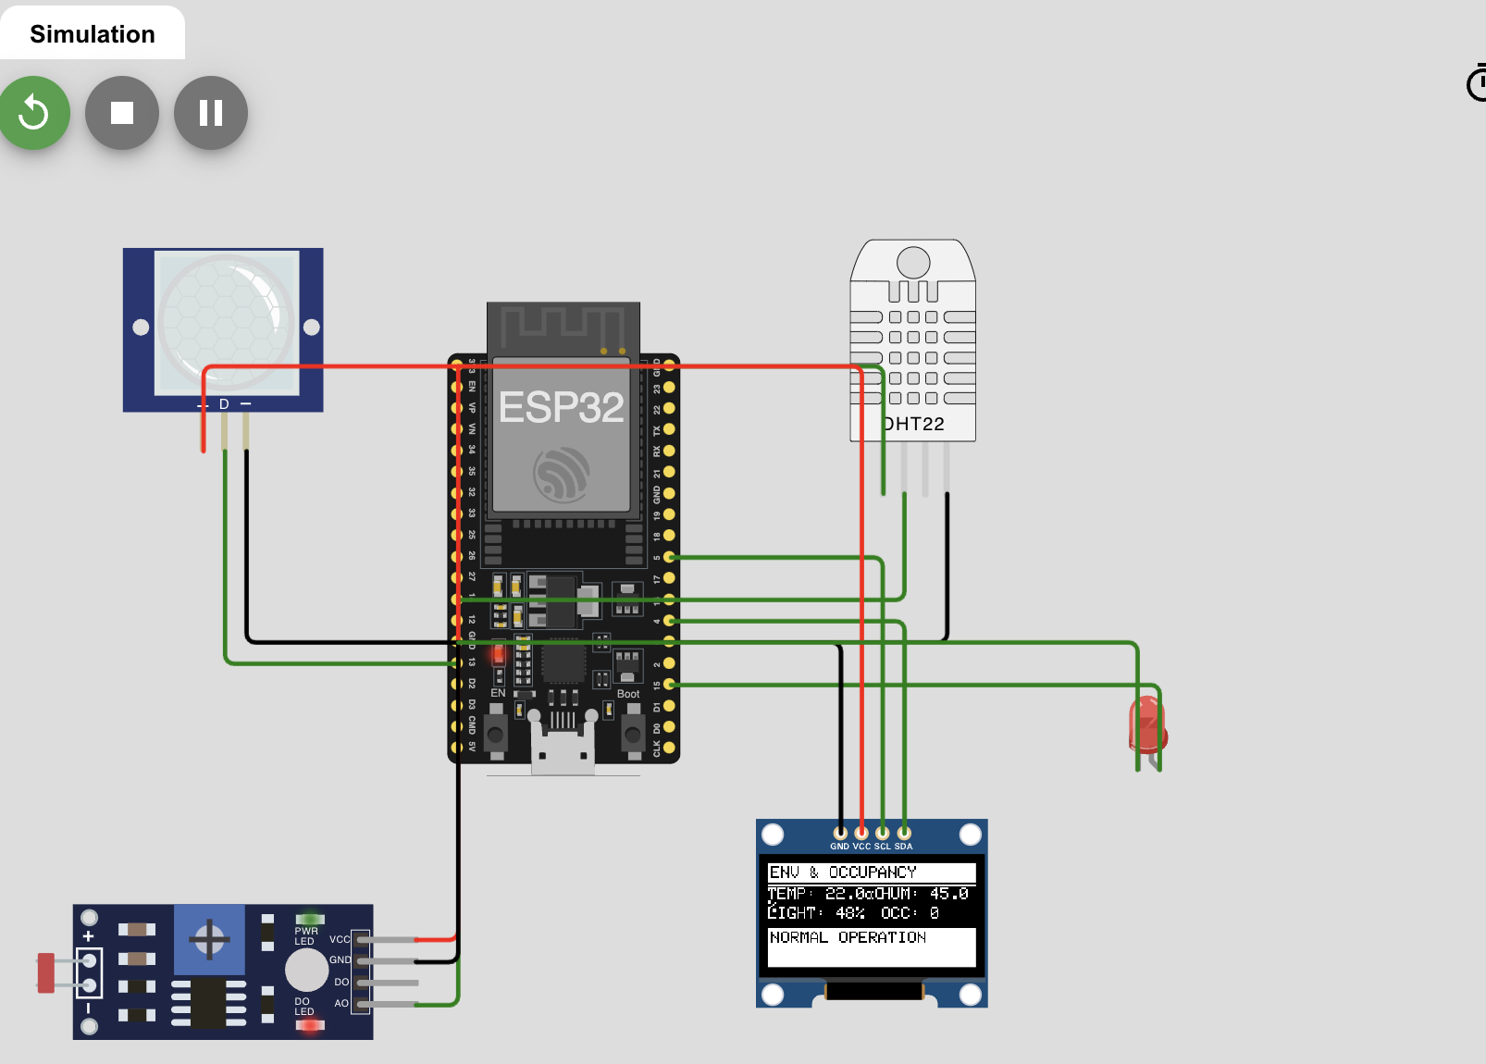
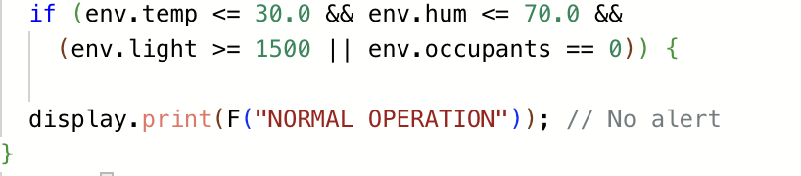
Test Cases and Results
Normal Operation:
Condition: Default state (no alerts)
Code Snippet:

Slide 16
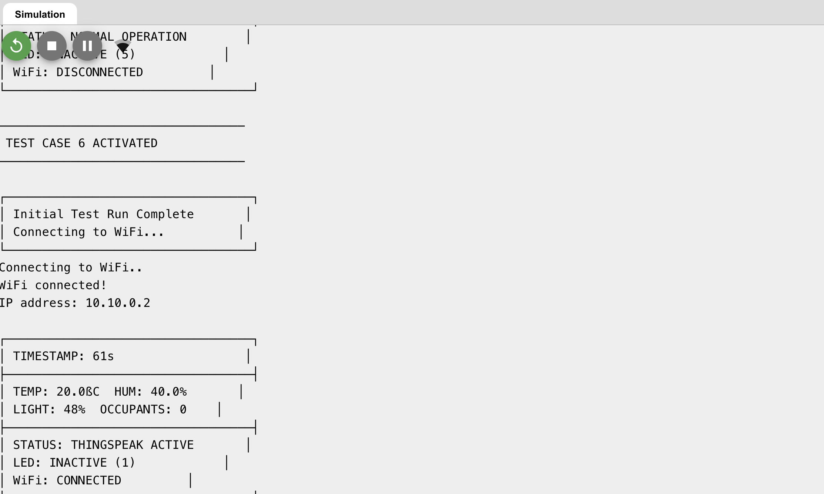
Data Visualization in Serial Monitor

Slide 17
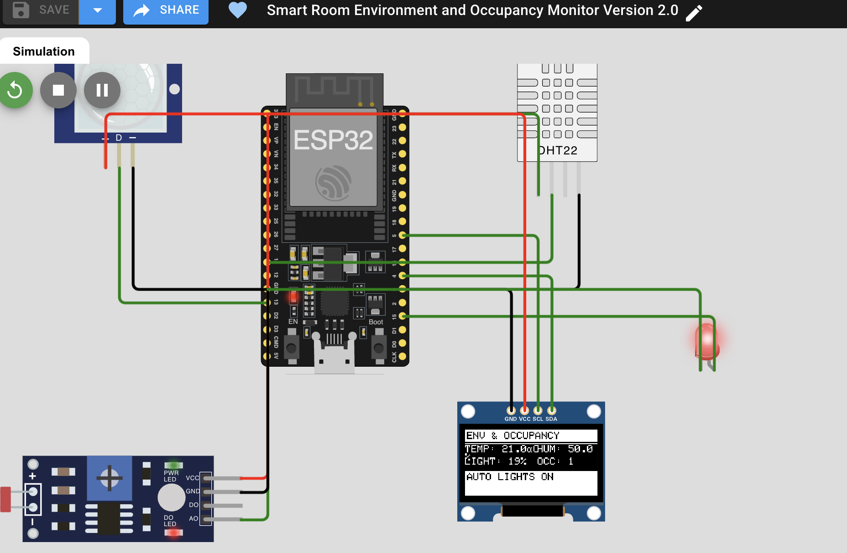
Data Visualization in OLED

Slide 18
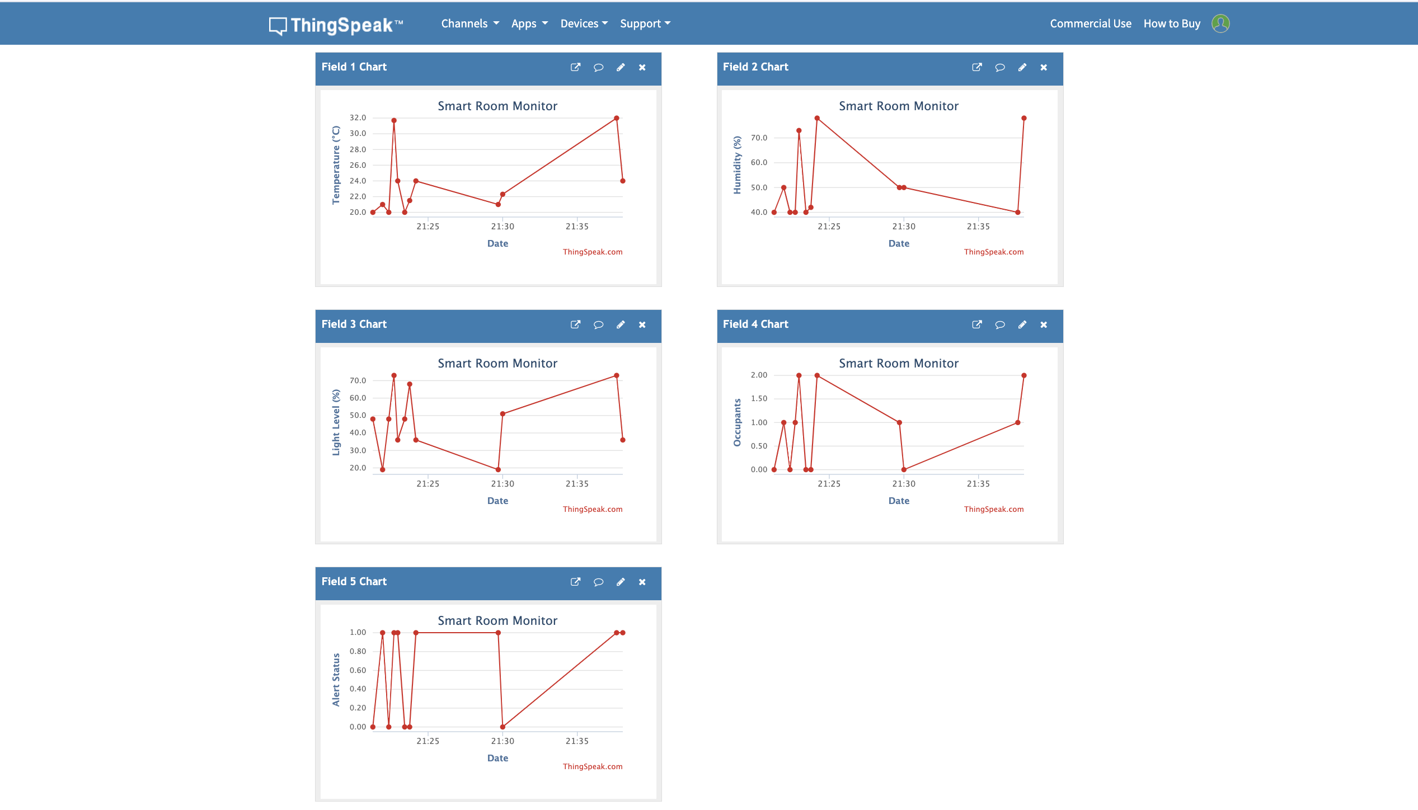
Data Visualization in Thingspeak

Slide 19
Demo
Here you can find the Wokwi and ThinkSpeak links:
Wokwi Simulation:
https://wokwi.com/projects/42834100541116416
ThingSpeak Dashboard:
https://thingspeak.mathworks.com/channels/2902740/private_show

Slide 20
Conclusion
Successfully Implemented:
Real-time monitoring of temperature, humidity, light, and occupancy using ESP32 and sensor fusion (DHT22, PIR, LDR).
Achieved energy-efficient automation with rule-based LED control.
Dual feedback: Local OLED display + Cloud (ThingSpeak) for remote monitoring.
Validated functionality via Wokwi simulation and hardware deployment.
Key Achievements:
Cost-effective compared to commercial BMS.
Modular design for easy expansion (e.g., adding CO₂ sensors).
Open-source C++ implementation for community adoption.

Slide 21
Future Work
Predictive Analytics:
Use ML algorithms (e.g., LSTM) to forecast occupancy patterns and optimize HVAC/lighting.
Pseudocode for predictive control: {if predict_occupancy(next_hour) > threshold: pre_cool_room()}
Mobile Integration:
Develop a companion app (Android/iOS) for real-time alerts and control.
Advanced Sensors:
Integrate air quality (CO₂, PM2.5) and noise sensors for holistic monitoring.
Scalability:
Deploy in smart campus/hospitals with multi-node LoRaWAN networks and Edge computing for faster response.
Security:
Add end-to-end encryption (MQTT over TLS) for secure cloud communication.
Commercialization:
Partner with IoT platforms (e.g., AWS IoT) for enterprise scalability.

Slide 22
Any Questions?
Your curiosity drives innovation-ask us-Let’s explore ideas together!

